Slide 1
Brain Computer Interface Term Project
Group 4
Member: 趙品瑄 陳姸沂 張瑀芯 楊佳誠 許瑋芸
Presenter: Pin-Hsuan Chao
Date: 2023/05/26

Slide 2
Outline
Introduction
Method
Experiment setting
Results
Discussion
Conclusion

Slide 3
Introduction
FBCNet: A Multi-view Convolutional Neural Network for Brain-Computer Interface
Author: Ravikiran Mane, Effie Chew, Karen Chua, Kai Keng Ang, Neethu Robinson, A. P. Vinod, Seong-Whan Lee, Cuntai Guan
https://doi.org/10.48550/arXiv.2104.01233

Slide 4
Introduction
Motor imagery-BCI
Participant performs mental rehearsal of a particular motor movement
MI-BCI systems shown promising results in post-stroke motor rehabilitation
MI-BCI challenge:
Lack of adequate training samples
Noisy high-dimensional feature
High inter-trial variance

Slide 5
Introduction: Current method for MI classification
Traditional machine learning method:
FBCSP-SVM
Riemannian geometry based methods
Suffer from the high susceptibility to intra-trial variance and have a high dependence on handcrafted features.
Deep learning method:
EEGNet
DeepConvNet

Slide 6
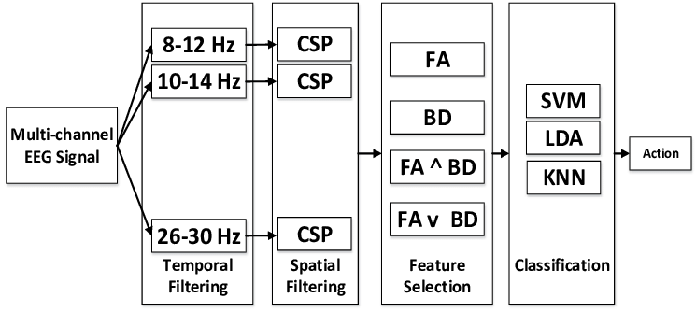
Filter bank common spatial pattern (FBCSP)
Notes:
This is the idea of filter bank common spatial pattern
Or FBCSP that I just mentioned
The unique idea about FBCSP is that it break down the raw multi channel EEG signal into several frequency band
Then perform common spatial pattern

Slide 7
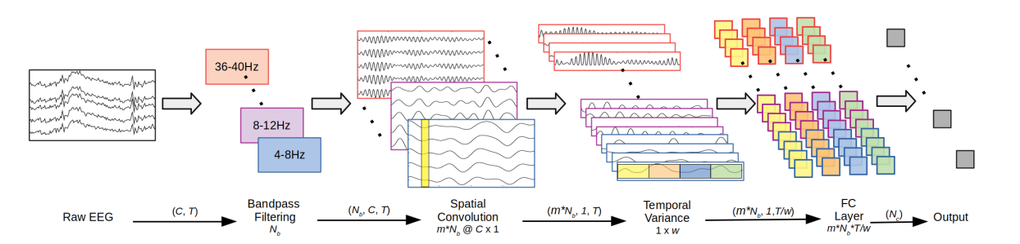
FBCNet architecture
Notes:
So the FBCNet adopt this idea and design this architecture accordingly
So let’s talk about this architecture one layer at a time

Slide 8
FBCNet architecture
Multi-view data representation: Spectrally filtering the raw EEG with multiple narrow-band filters
The “Filter Bank” from FBCSP
Spatial transformation learning: spatial discriminative patterns learned using a Depthwise Convolution layer
Notes:
In the first multi-view data representation
They band pass filter the Channel by time Raw EEG data into Nb number of frequency band
This is why it’s call FBCNet, is the filter bank part from the FBCSP
Then similar to FBCSP, they put a spatial convolution block here to extract spatial discriminative patterns
Using a depthwise convolution layer

Slide 9
FBCNet architecture
Temporal feature extraction: novel Variance layer is used to effectively extract the temporal information
Classification: log activation to FC layer, then passed to softmax layer to get the output probabilities of each class
Notes:
Then the temporal feature extraction is done by a novel variance layer
The role of this layer is similar to a pooling layer, we’ll look at this layer in detail later
The finnaly the classification part of this architecture
The features go through log activation then fully connected layer
Then passed to softmax layer to get the output probabilities

Slide 10


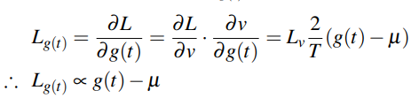
FBCNet architecture: Variance layer
Reduces the number of features from (m×Nb×T) to (m×Nb×T/w)
Output of Variance layer:
The effect of Variance layer is more significant for the EEG data during the learning phase using gradient descent optimization
Loss from this layer:
Notes:
So now let’s talk about the variance layer
The main point of this layer is to reduces the number feature by using a time window with the length w to represent the time series
So the output of this variance layer is the data deviation within the time window from the mean value
In the context of FBCNet architecture it can be notated like this
The effect of this variance layer is more significant in the loss
Through this simple derivation
We can see that the loss would be proportional to deviation of g(t) from the mean of the signal
Lv: incoming loss at the variance layer
Lg(t): backpropagated loss from this layer with respect to the input g(t)
CSP: Spatial Convolution Block
the backpropagated loss from the Variance layer is proportional to the deviation of g(t) from the mean of the signal

Slide 11
Method
Dataset:
Original paper: 4 dataset (BCIC-IV-2A, OpenMBI Data, Stroke Data A, Stroke Data B)
Ours: used BCIC-IV-2A only
Baseline model comparison:
Original paper: compared FBCNet against FBCSP-SVM, EEGNet, DeepConvNet
Ours: compared FBCNet against EEGNet, ShallowConvNet, SCCNet
Training scheme:
Original paper: 10-fold cross validation, HO(individual)
Ours: 10-fold cross validation, HO(individual), subject independent for 9 subjects
Notes:
Our method for implementing and experiment on FBCNet

Slide 12
Experiment setting
Stage 1:
The model was trained using only the training set
Stopped if no increase in the validation set accuracy for consecutive 200 epochs
network parameters with the best validation set accuracy were restored
Stage 2:
Training procedure was continued in the second stage wherein the model was trained with the complete training data (train + validation set)
Stopped when the validation set loss reduced below the stage 1 training set loss
To avoid infinite training in the situation of non-convergence, the maximum number of training epochs were limited to 1500 and 600 for training stage 1 and 2 respectively

Slide 13
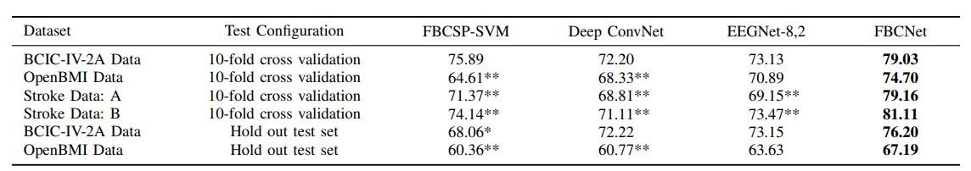
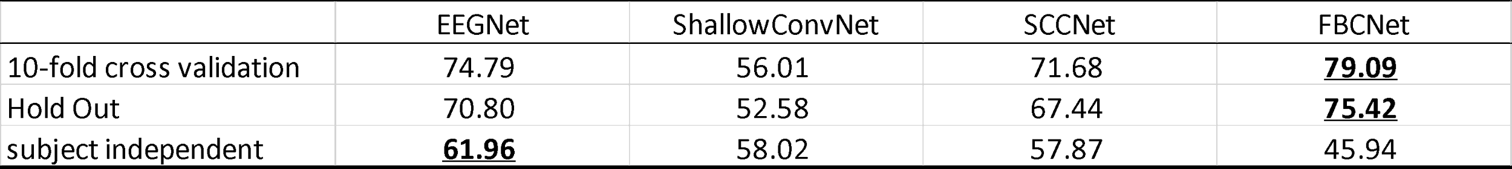
Results
Original:
Ours:
Notes:
The results from 10-fold cross validation for FBCNet and EEGNet is really close to the results reported by original paper
79.03 79.09
73.13 74.79
There is a little difference in results from hold out, which is basicly individual training scheme
But I think this can be expected since there is probably more variability from smaller data size
As we can see, FBCNet not only outperform all other method including traditional machine learning like FBCSP SVM
And DEEP EEGNET in the original paper
In our results, it outperformed other baseline architecture as well
However, in subject independent test, FBCNet actually had the worst performance in terms of accuracy

Slide 14
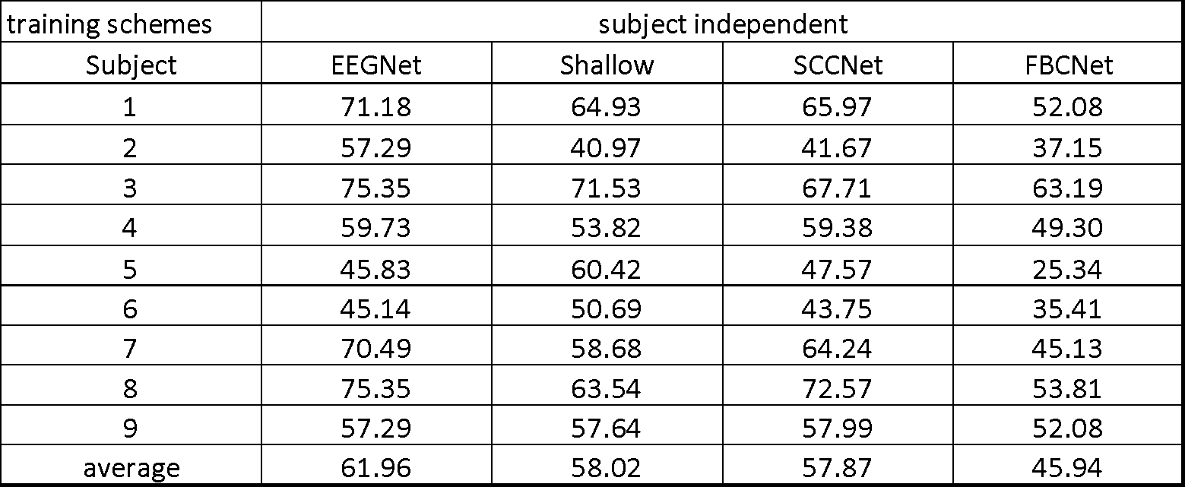
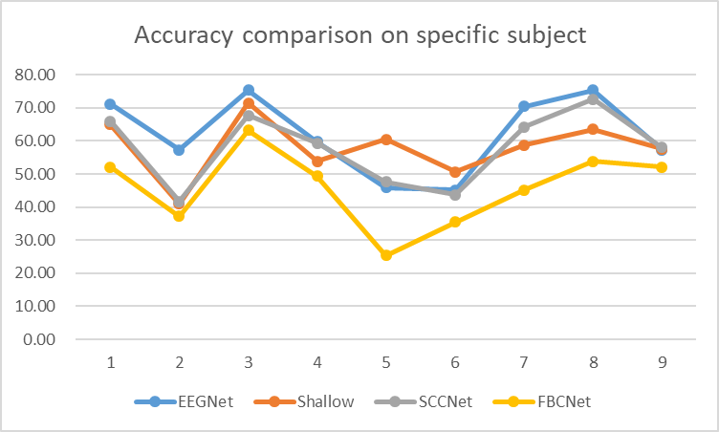
Discussion
FBCNet performance on specific subjects in subject independent scheme:
Notes:
In the discussion section
We’ll try to analyze the performance in subject independent scheme
So this is the results for all subjects in subject independent scheme
As we can clearly see there’s really large variability across subject
Especially for subject 5, where the accuracy of FBCNet is basicly the same as randomly guessing
But even if we exclude subject 5 as outlier, FBCNet still consistently performed the worst

Slide 15
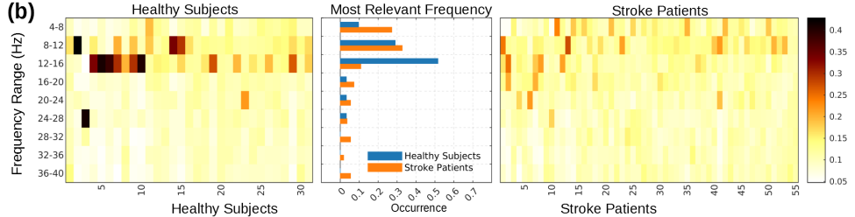
Discussion
Role of Variance Layer
Variance of a filtered signal represents the spectral power in the time-series
Spatio-temporal differences in spectral power are known class-discriminative features of MI
Difference in individual spectral characteristic may explain the lower accuracy of FBCNet in subject independent scheme
Notes:
We can speculate on why FBCNet has poor performance compare to other architecture
So the reason they put the variance layer is to represents the spectral power in the time series
And The Filter bank and the variance layer may be able to efficiently extract this type of individual spectral characteristic
However, Difference in individual spectral characteristic may explain the lower accuracy of FBCNet as well
So the bottom figure is from the original paper
Where they compare the importance of spectral feature between healthy subjects and stroke patients
But even if we look at healthy subjects
There is still large difference in spectral characteristic
We think this explain FBCNet performance in subject independent scheme
Especially for subject where the spectral characteristics are considerably different

Slide 16
Conclusion
We implement FBCNet and compare it against several baseline model in different training scheme
As the original paper suggested, FBCNet performed well possibly by learning subject specific spectral power related feature
However, for subject independent scheme, other general-purpose architectures (EEGNet, ShallowConvNet, SCCNet) still out-performed FBCNet

